Slide 1
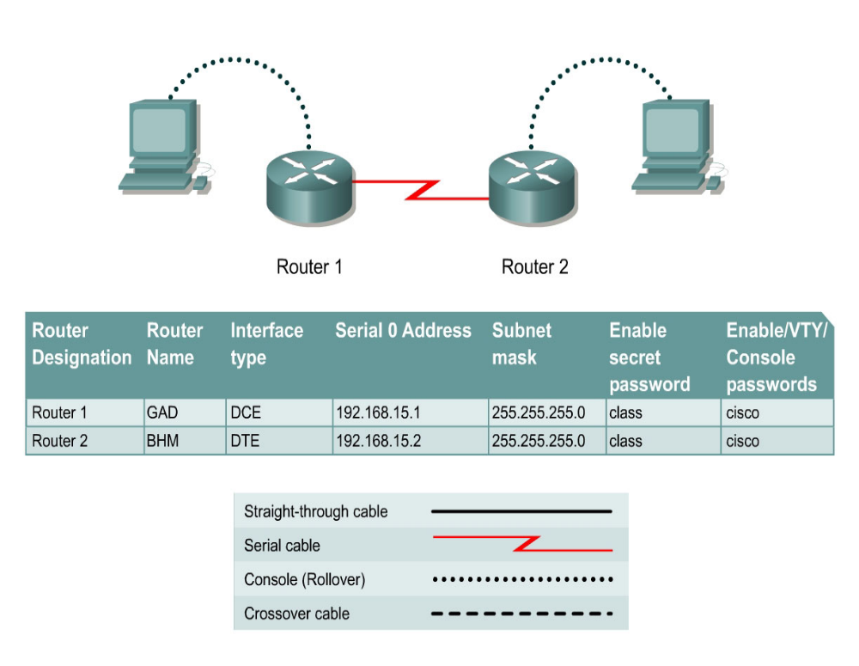

Slide 2
Step 1 Basic Router Configuration
  Configure the router. Connect the routers as shown in the diagram. This lab requires a null serial cable and two rollover or console cables.

Slide 3
Step 2: Configure the name and passwords for Router 1
a. On Router 1, enter the global configuration mode and configure the hostname as shown in the chart.
b. Configure the console, virtual terminal and enable passwords

Slide 4
Step 3 Configure serial interface Serial 0/0/0
  Configure serial interface Serial 0 on Router GAD.
    GAD(config)#interface serial 0/0/0
    GAD(config-if)#ip address 192.168.15.1 255.255.255.0
    GAD(config-if)#clock rate 56000
    GAD(config-if)#no shutdown
    GAD(config-if)#exit
    GAD(config)#exit

Slide 5
Step 5 Display information about Serial interface 0 on GAD
  a. Enter the command show interface serial 0 on GAD
  GAD#show interface serial 0/0/0
  b. List at least three details discovered by issuing this command.
  c. Serial 0 is ___________________. Line protocol is___________________ .
  d. Internet address is _____________________.
  e. Encapsulation _________________________
  g. If the Serial interface was configured, why did the show interface serial 0 say that the interface is down?

Slide 6
Step 6: Configure the name and passwords for Router 2
Step 7: Configure serial interface Serial 0/0/0
    BHM(config)#interface serial 0/0/0
    BHM(config-if)#ip address 192.168.15.2 255.255.255.0
    BHM(config-if)#no shutdown
    BHM(config-if)#exit
    BHM(config)#exit

Slide 7
Step 8 Save the running configuration
  Save the running configuration to the startup configuration at the privileged EXEC mode:
  BHM#copy running-config startup-config

Slide 8
Step 9 Display information about Serial interface 0 on BHM
Step 10 Verify that the serial connection is functioning
  a. ping the serial interface of the other router.
    BHM#ping 192.168.15.1
    GAD#ping 192.168.15.2

Slide 9
From GAD, ping the BHM router serial interface. Does the ping work? _________________
c. From BHM, ping the GAD router serial interface. Does the ping work? _________________

Slide 10
Erasing and reloading the router

